Slide 1
Detection of chatter from time series data in turning
Sayantika Ghosh
M.Tech Smart Manufacturing

Slide 2
Paper title
Chatter Detection in Turning Using Machine Learning and Similarity Measures of Time Series via Dynamic Time Warping

Slide 3
Summary
Used K-Nearest Neighbor (kNN) algorithm for classification and Dynamic Time Warping (DTW) as time series similarity measure.
Used the x-axis signal from tri-axial accelerometer obtained from a series of turning experiments for analysis.
A set of four cutting configurations were used and for each of them various values of cutting speed and depth of cut were tested. These cutting configurations were based on the stickout distances which is the distance between back side of the cutting tool holder and the hell of the boring bar. Changing the stickout distance varies the stiffness of the boring rod, and consequently the corresponding chatter frequencies.
For each cutting configuration data, it was split into training and testing set.

Slide 4
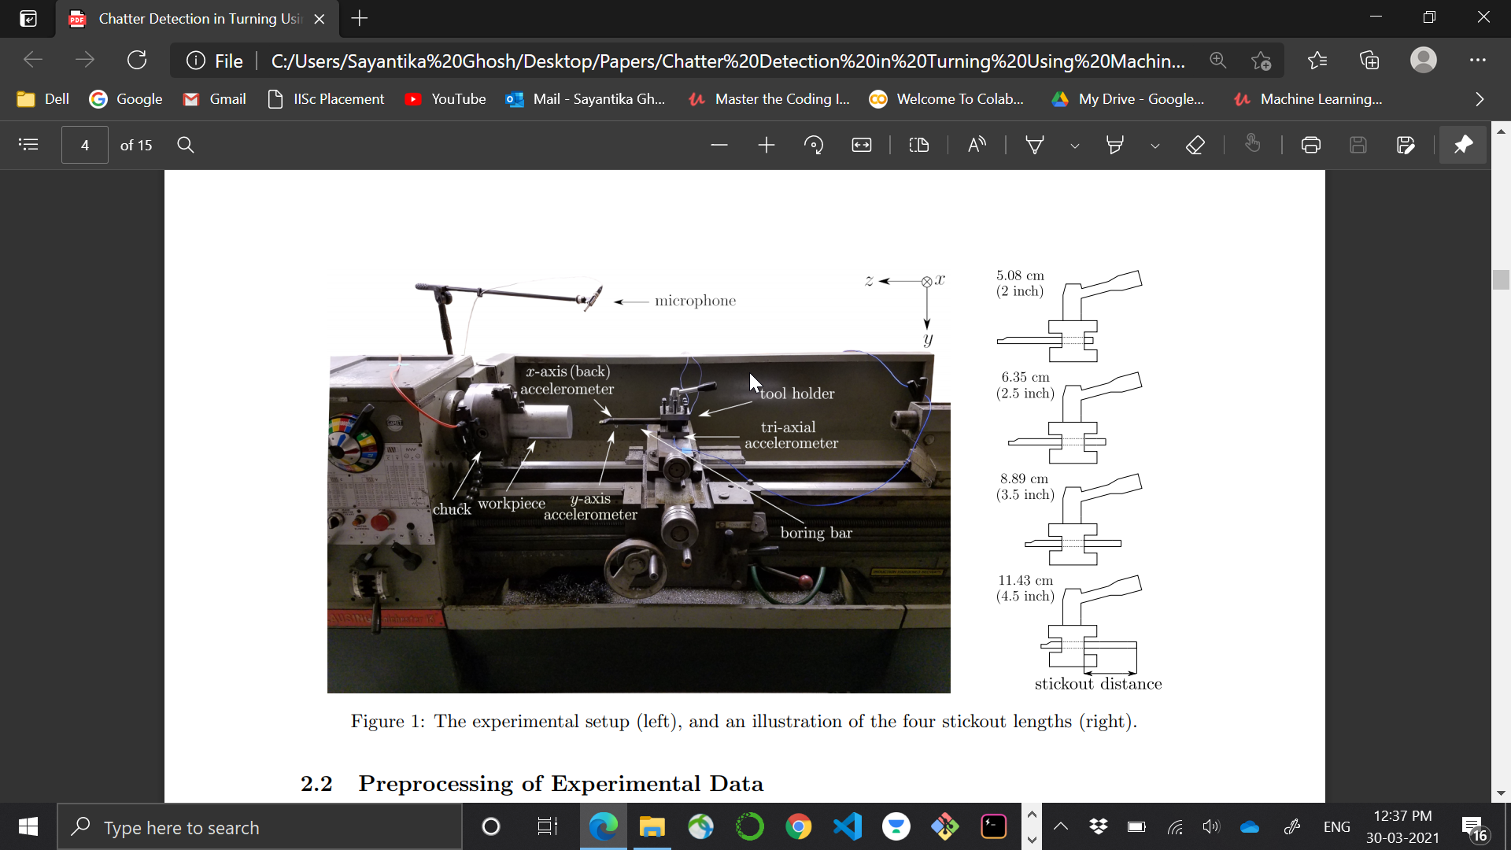

Slide 5
Summary
Pairwise distance matrices were computed in the training set using DTW and then KNN classifier was trained to classify signals as chatter or no chatter. In this implementation Euclidean distance was used.
These train test split was randomly varied ten times and the average test accuracy and standard deviation was noted.
A criteria for classifying the signal as no-chatter, intermediate chatter and full chatter were established.
Compared the result obtained with the traditional methods – Wavelet Packet Transform (WPT) and Ensemble Empirical Mode Decomposition (EEMD) as well as the Topological Data Analysis (TDA) based approach.

Slide 6
Issues in the past methods
Traditional methods using WPT and EEMD required a significant amount of pre-processing of data for training the classifier which required skilled knowledge.
It was sensitive to the train and test set used. These methods showed a decrease in accuracy if the cutting conditions were shifted, or two different chatter frequency were used.
These algorithms like Variational Mode Decomposition (VMD) were highly specialized to the process generating the data.
Using WPT and EEMD for distinguishing chatter from intermediate chatter is difficult because although the time-domain signals in these two cases are different, their corresponding frequency spectra are too close.
Artificial Neural Networks (ANN) were also used to classify chatter, but these requires large training set which is not always available for small batch production.
Recent methods like TDA produced reasonable accuracy but the transfer learning capabilities of these methods have not been tested yet and reducing their computational time is a current topic of research. TDA requires embedding the data into a point cloud which is a very complicated process.

Slide 7
Solution to the above issues
In contrast to WPT and EEMD, no pre-processing is necessary for DTW since it operates on the original signals, and it does not require the signals to have the same lengths.
DTW have excellent transfer learning capabilities which means that the classifier trained on one training set with some cutting configuration is robust enough to the dynamic changes in the cutting parameters during manufacturing.
DTW could classify signals into chatter and intermediate chatter using features extracted in the time domain because the power spectrum in time domain significantly varied as compared to the frequency domain which were similar making featurization in the frequency domain extremely challenging.
This uses reasonable sized dataset unlike ANN.
However, DTW has the longest running time as compared to other methods and this is because the current python implementation is not the most optimized one. Further optimization can be made in the code to get a better running time.
DTW avoids the complication associated with choosing appropriate embedding parameters.

Slide 8
Criterion for classification of signals
For classifying the time series, the peaks in both the time and frequency domains were observed. These tags were verified by measuring the surface roughness of the workpiece.
Signal having LOW peaks in BOTH the domains
INTERMEDIATE CHATTER
Signal having LOW peaks in the TIME domain but having HIGH peaks in the FREQUENCY domain.
STABLE OR CHATTER FREE
FULL CHATTER
Signal having HIGH peaks in both the domains.
UNKNOWN
Any signal that did not fit any of the above criteria.

Slide 9
Results
For three out of four cutting configurations, DTW-based approach attains the highest average classification rate reaching in one case as high as 99% accuracy.
DTW possesses excellent transfer learning accuracy whereby the classifier is tested on a cutting configuration different from the one that was used for training. It achieve high classification accuracies even if the system parameters shift during the manufacturing process.
It successfully distinguishes between chatter and intermediate chatter. These comparisons are difficult or impossible using only frequency domain features because the frequency content in these two cases is too similar while the time domain signals are different.

Slide 10
Future Prospect
To use the optimized version of DTW which reduces the running time of the algorithm discussed in one of the paper given in references.
Can use different combination of classifiers and compare the result obtained.

Slide 11
Paper title
Permutation entropy based real-time chatter detection using audio signal in turning process

Slide 12
Summary
Used permutation entropy (PE) for the detection of onset of chatter from the time series using the audio signals recorded with a unidirectional microphone.
In the present study, the variation of PE under two cutting conditions is analyzed - sudden increase of depth of cut (b) continuous increase of depth of cut on mild steel work pieces.
The results are verified using frequency spectra of the signals and the nonlinear measure, normalized coarse-grained information rate (NCIR). For highly regular and thereby predictable systems, NCIR is close to 1 whereas for irregular systems it is close to 0.

Slide 13
Summary
PE characterizes the system dynamics, with low values indicating regular behavior. Any increase in PE value will thus represent a tendency of increase in irregularity in the dynamics. For detection of dynamical changes from time series, it is first partitioned into nonoverlapping windows of suitable length T. PE for each window is calculated. Any change in the dynamics of the system will be reflected in the variation of PE with respect to a moving window. The window length T should be greater than n! where n is the order of PE. Optimum values of order of PE are reported to be around 5 to 8. PE of order 6 is used for a window size of 1,024 samples were used here. Variation of PE with respect to moving windows is used for detection of onset of chatter.
Fifteen records are acquired for each cutting process and the corresponding time series are used for PE analysis and signals are sampled at 11 kHz to generate the time series.

Slide 14
Adavntages of using PE for chatter detection
Simple measurement
Computationally fast
In situations where the data sets are huge and there is no time for preprocessing and fine-tuning, PE can effectively detect dynamical changes of the system.
There is no need for embedding dimension and reconstruction of state space which is computationally intensive.
It gives reliable results even in the presence of noise.

Slide 15
Prediction of chatter using PE
PE is expected to show relatively no change during chatter-free cutting. As the chatter vibrations develop during the cutting process, due to the increased predictability of the system dynamics PE values are expected to decrease.

Slide 16
Results
The results of our study show concurrence of a drop of PE with increase in NCIR.
FIRST EXPERIMENT
There is drop in PE which indicates increase in regularity of the dynamics thereby indicating the onset of chatter when the depth of cut is abruptly increased.
From the statistical analysis, it is observed that p values of all the cases are found to be less than 1e−15, indicating that the null hypothesis of the two samples of pre-chatter PE and chatter PE coming from distributions with equal means should be rejected. From these results, a simple threshold for PE of sudden change in depth of cut can be set at a value of 0.8620.

Slide 17
Results
The development of harmonic peaks is indicative of more regular behavior which in turn represents the presence of chatter vibrations.
Increase in NCIR values confirms the presence of chatter vibrations as indicated by change in PE values.
SECOND EXPERIMENT
PE values do not undergo any drastic variation along the range of depth of cut from 0 to 0.4 mm.
From 0.4 mm depth of cut onwards there is change in PE value thereby indicating onset of chatter.

Slide 18
Results
p values of all the cases are found to be less than 0.05, indicating that the null hypothesis of the two samples of pre-chatter PE and chatter PE coming from distributions with equal means should be rejected. From the results of this statistical analysis, a simple threshold for PE for continuously increasing depth of cut can be set at a value of 0.86.
At 0.46 mm depth of cut change in PE is more pronounced than in other regions.
It can be inferred from the figure that NCIR values show an increase at 0.46 mm depth of cut.

Slide 19
Future Prospects
Can this measure be applied to signals coming from a variety of sensors like dynamometer, accelerometer and perform a comparative study on how well this performs.

Slide 20
References
Yesilli MC, Khasawneh FA, Otto A. Chatter Detection in Turning Using Machine Learning and Similarity Measures of Time Series via Dynamic Time Warping. ArXiv:1908.01678v1 [eess.SP]. 5 Aug 2019.
Rakthanmanon T, Campana B, Mueen A, Batista G, Westover B, Zhu Q, Zakaria J, and Keogh E. Searching and mining trillions of time series subsequences under dynamic time warping. Proceedings of the 18th ACM SIGKDD international conference on Knowledge discovery and data mining; pp. 262– 270; ACM, 2012.
Nair U, Krishna BM & Namboothiri VNN & Nampoori VPN. Permutation entropy based real-time chatter detection using audio signal in turning process. Int J Adv Manuf Technol (2010) 46:61–68 DOI 10.1007/s00170-009-2075-y.

Slide 21
Task For Next Week
Practical implementation of these methods using the dataset given in the first paper.
Look for papers wherein autoencoders were used for chatter detection in turning.

Slide 22
Thank You

